Slide 1

Community Advisory Group
Update
700S 1600E PCE Plume Superfund Site
17 JULY 2024
Veterans Health Administration – SLC VA Medical Center
Shannon Smith – Program Manager
Wynn John – Technical Manager
Zane Kozarec – Project Engineer
VHASLCSuperfund@va.gov PCEPlume.org

Slide 2
Introduction
The SLC VAMC operated a dry-cleaning machine that used tetrachloroethylene (abbreviated as PCE) in the late 1970s and early 1980s.
During this period, dry-cleaning residuals were likely disposed of into the sanitary sewer system which leaked into the ground.
PCE-contaminated groundwater is present beneath the VAMC property and in areas downgradient, extending to approximately 1100 East.
PCE
PCE is a colorless liquid used for dry cleaning fabrics and degreasing metals.
Long-term exposure (longer than one year) to low levels of PCE may cause damage to the nervous system (neurotoxicity), vision issues, and cancer.

Slide 3
Remedial Investigation Overview
Site Discovery and NPL Listing
Characterization Remedial Investigation / Feasibility Study
Remedy Selection
Record of Decision
Cleanup
CERCLA/SUPERFUND Process
The site Remedial Investigation was conducted from 2015-2022. It involved:
  collecting over 900 environmental samples to evaluate the extent of PCE, and
  evaluating the potential risks to human health.
The Remedial Investigation Report (RI) was finalized in Sep 2022 and is available at www.PCEPlume.org in the Administrative Record under the Resources tab.

Slide 4
Remedial Investigation Findings
The RI identified two potential health risks:
  Indoor Air Vapor Intrusion (inhalation) – vapor intrusion from soil gas or groundwater into structures
  Groundwater ingestion – potential future use of untreated groundwater for domestic purposes
The Feasibility Study (FS) will evaluate cleanup options that address groundwater contamination (the source of the two potential health risks).

Slide 5
Feasibility Study (FS)
Technology Pre-screening
Develop Remedial Actions
Treatability Study (if needed)
Remedy Selection
Feasibility Study: The process of developing, screening, and evaluating remedial action (cleanup) alternatives
Main objective: determine treatment technologies that will effectively reduce risks to human health in a reasonable timeframe
Study will focus on groundwater treatment technologies based on the risks identified in the RI
Additional data collection and treatability studies (small-scale field studies) will be conducted as part of the process

Slide 6
Treatability Studies and Monitoring Wells
DRAFT

Slide 7
Treatability Studies and Monitoring
Study | Location | Objective
Bioremediation Amendment Injection Test | West side of VA Medical Center (area with highest onsite PCE concentrations) | Reduce PCE groundwater concentrations and evaluate injection efficiency.
Aquifer Performance Test | West side of VA Medical Center | Define aquifer characteristics that would affect injection and extraction efficiency.
MW-39 “Sentinel” Monitoring Well | University of Utah Parking Lot, southeast of intersection of Guardsman Way and 500 South. | Assess deep groundwater (greater than 200 ft) contamination near SLC municipal water well if returned to use (not currently in service)

Slide 8
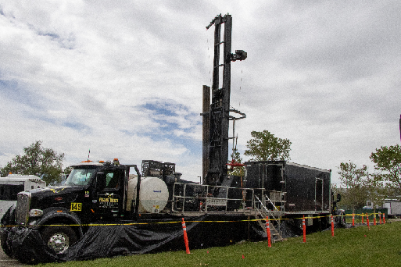
Field Work
  Complete well installation (ongoing)
  Treatability Studies planned to start in August 2024
  Additional groundwater sampling will also be conducted.
  Anticipate data sets will be available to discuss in approximately nine months.

Slide 9
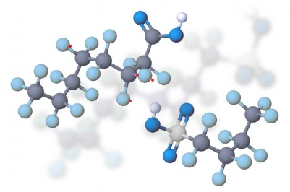
PFAS Question
EPA expressed concerns about potential PFAS contamination at the site associated with healthcare operations.
PFAS – Are manufactured chemicals widely used in industry and consumer products, including healthcare equipment and devices, pharmaceuticals, cleaning products and stain- and water-resistant treated materials.
Propose to conduct a Preliminary Assessment/Site Inspection (PA/SI) with limited initial sampling.
  PA/SI plan is being prepared.
  Anticipate collecting groundwater from existing monitoring wells.

Slide 10
Next Meeting and Questions
Agenda items for next meeting?
Contact Info:
Shannon Smith
Department of Veterans Affairs
CERCLA Program Manager
shannon.smith92@va.gov
801-582-1565 x2021
Wynn John
Department of Veterans Affairs
CERCLA Technical Manager
william.john@va.gov
801-582-1565 x6603
Zane Kozarec
Department of Veterans Affairs
Project Engineer
zane.kozarec@va.gov
801-582-1565 x1952

